Slide 1
Introduction

Slide 2
Objectives
After completing this lesson, you should be able to do the following:
  Describe the objectives of the course
  Describe the course agenda
  Identify the database tables used in the course
  Identify the Oracle products that help you design a complete business solution
Notes:
Lesson Aim
This lesson gives you a high-level overview of the course and its flow. You learn about the database schema and the tables that the course uses. You are also introduced to different products in the Oracle 10g grid infrastructure.

Slide 3
Course Objectives
After completing this course, you should be able to do the following:
  Understand that PL/SQL provides programming extensions to SQL
  Write PL/SQL code to interface with the database
  Design PL/SQL program units that execute efficiently
  Use PL/SQL programming constructs and conditional control statements
  Handle run-time errors
  Describe stored procedures and functions
Notes:
Course Objectives
This course presents the basics of PL/SQL. You learn about PL/SQL syntax, blocks, and programming constructs and about the advantages of integrating SQL with those constructs. You learn how to write PL/SQL program units and execute them efficiently. In addition, you learn how to use iSQL*Plus as a development environment for PL/SQL. You also learn how to design reusable program units, such as procedures and functions.

Slide 4
Course Agenda
Lessons for the first day:
  I. Introduction
  1. Introduction to PL/SQL
  2. Declaring PL/SQL Variables
  3. Creating the Executable Section
  4. Interacting with the Oracle Database Server
  5. Writing Control Structures

Slide 5
Course Agenda
Lessons for the second day:
  6. Working with Composite Data Types
  7. Using Explicit Cursors
  8. Including Exception Handling
  9. Creating Stored Procedures and Functions

Slide 6
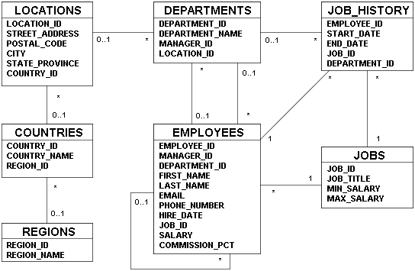
Human Resources (hr) Data Set
Notes:
Human Resources (hr) Data Set
The Human Resources (hr) schema is a part of the Oracle sample schema that can be installed into an Oracle database. As the name indicates, the hr schema has tables that store all the information about all employees working in the organization. To reduce the complexity and volume of data, information about employees is stored in more than one table. For example, if an employee works in the education department, it is not necessary to store information about that employee as well as the education department in one table. Instead, you can store employee information in the employees table and department information in the departments table. This is how the hr schema is built.
The slide shows the hr schema tables and their relationships.
Table Descriptions
employees contains details about each employee working for a department. Some employees may not be assigned to a department.
departments contains details about the departments in which employees work. Each department may have a relationship representing the department manager in the employees table.

Slide 7
Notes:
Human Resources (hr) Data Set (continued)
Table Descriptions (continued)
jobs contains the job types that can be held by each employee.
job_history contains the job histories of employees. If an employee changes departments within the job or changes jobs within the department, a new row is inserted into this table with the old job information of that employee.
locations contains the specific addresses of the offices, warehouses, and/or production sites of a company in a particular country.
regions contains rows representing a region (such as Americas, Asia, and so on).
countries contains rows for countries, each of which are associated with a region.
Note: This lesson introduces you to the various tables in the hr schema. If you want to see the data stored in each table, refer to Appendix B (“Table Descriptions and Data”).

Slide 8



Oracle10g Grid Infrastructure
Notes:
Oracle10g Grid Infrastructure
There are three grid infrastructure products in the Oracle10g release:
Oracle Database 10g
Oracle Application Server 10g
Oracle Enterprise Manager 10g Grid Control

Slide 9






Oracle Database 10g
Object Relational Data
Documents
Multimedia
Messages
Notes:
Oracle Database 10g
Oracle Database 10g is designed to store and manage enterprise information. By using Oracle Database 10g, management can reduce costs and be assured of a high quality of service. Reduced configuration and management requirements and automatic SQL tuning have significantly reduced the cost of maintaining the environment.
Oracle Database 10g contributes to the grid infrastructure products of the Oracle 10g release. Grid computing is all about computing as a utility. If you are a client, you need not know where your data resides or which computer stores it. You should be able to request information or do computations on your data and have it delivered to you.
Oracle Database 10g manages all your data. This is not just the object relational data that you expect an enterprise database to manage. It can also be unstructured data, such as:
Spreadsheets
Word documents
PowerPoint presentations
XML
Multimedia data types (MP3, graphics, video, and so on)
The data does not even have to be in the database. Oracle Database 10g has services through which you can store metadata about information stored in file systems. You can use the database server to manage and serve information wherever it is located.

Slide 10


Oracle Application Server 10g
Portals
Transactional applications
Business intelligence
Integration
Application development framework
Application server
Notes:
Oracle Application Server 10g
Oracle Application Server 10g provides a complete infrastructure platform for developing and deploying enterprise applications, integrating many functions including a J2EE and Web services run-time environment, an enterprise portal, an enterprise integration broker, business intelligence, Web caching, and identity management services. Oracle Application Server 10g adds new grid computing features, building on the success of Oracle9i Application Server, which has hundreds of customers running production enterprise applications.
Oracle Application Server 10g is the only application server to include services for all the different server applications that you want to run. It can run:
Portals and Web sites
Java transactional applications
Business intelligence applications
It also provides integration between users, applications, and data throughout your organization.

Slide 11
Oracle Enterprise Manager 10g
Grid Control
  Software provisioning
  Application service-level monitoring
Notes:
Oracle Enterprise Manager 10g Grid Control
Oracle Enterprise Manager 10g Grid Control is a complete, integrated, central management console and underlying framework that automates administrative tasks across sets of systems in a grid environment. With Grid Control, you can group multiple hardware nodes, databases, application servers, and other targets into single logical entities. By executing jobs, enforcing standard policies, diagnosing and monitoring performance, and automating many other tasks across a group of targets instead of on many systems individually, Grid Control enables scaling with a growing grid.
Software Provisioning
With Grid Control, the Oracle 10g platform automates installation, configuration, and cloning of Oracle Application Server 10g and Oracle Database 10g across multiples nodes. Oracle Enterprise Manager provides a common framework for software provisioning and management, allowing administrators to create, configure, deploy, and utilize new servers with new instances of the application server and database as they are needed.
Application Service-Level Monitoring
Grid Control views the availability and performance of the grid infrastructure as a unified whole, as a user would experience it, rather than as isolated storage units, processing boxes, databases, and application servers.

Slide 12



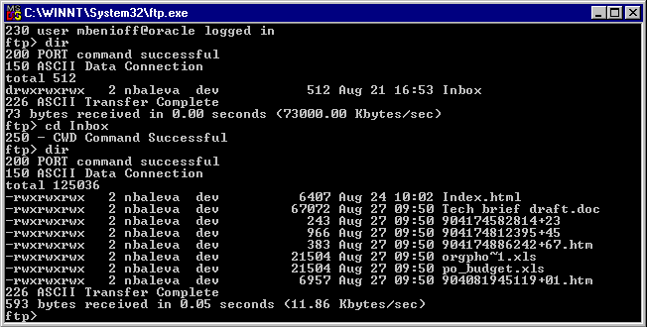





Oracle Internet Platform
Clients
Any
browser
Any
mail client
Any
FTP client
Internet applications
Business logic
and data
Presentation and
business logic
SQL
Development tools
System management
PL/SQL
Databases
Application
servers
Java
Network services
Notes:
Oracle Internet Platform
To develop an e-commerce application, you need a product that can store and manage the data, a product that can provide a run-time environment for your applications implementing business logic, and a product that can monitor and diagnose the application after it is integrated. Oracle 10g grid infrastructure products, discussed earlier, provide all the necessary components to develop your enterprise. Oracle offers a comprehensive, high-performance Internet platform for e-commerce and data warehousing. This integrated platform includes everything needed to develop, deploy, and manage Internet applications.
The Oracle Internet Platform is built on three core pieces:
Browser-based clients to process presentation
Application servers to execute business logic and serve presentation logic to browser-based clients
Databases to execute database-intensive business logic and server data
Oracle offers a wide variety of the most advanced graphical user interface (GUI) driven development tools to build business applications, as well as a large suite of software applications for many areas of business and industry. Stored procedures, functions, and packages can be written by using SQL, PL/SQL, or Java.

Slide 13
Summary
In this lesson, you should have learned how to:
  Describe the course objectives and course agenda
  Identify tables and their relationships in the hr schema
  Identify the various products in the Oracle 10g grid infrastructure that enable you to develop a complete business solution

Slide 14
Notes:
Course Practices
When you perform the practices in the course, you develop a simple application using an anonymous block. This anonymous block covers the following:
Writing a declarative section
Declaring variables of scalar types
Declaring variables using the %TYPE attribute
Writing an executable section
Accepting user inputs for variables
Retrieving the values from the database and storing the values in the variables by using the INTO clause
Writing a nested block within the executable section
Using the control structures in the executable section to perform business logic
Using the INDEX BY table to store values and print them
Handling exceptions
What Is the Functionality of This Application?
This application is a simple HR application, and only employees working in the Human Resources department are authorized to use it. In the employees table, only one employee is in the HR department. Therefore, you can use employee_id for authentication.
The company has decided to provide salary raises to employees in certain departments this quarter. The raise percentages are determined by the employees’ current salaries.
Employees in the following departments are eligible for raises this quarter:
The salary ranges and the resulting raise percentages are as follows:

